Slide 1

NAMA Foundation is an international grant provider organization incorporated in 2004 under the Companies Act 1965 (Malaysia) as a non for profit Company Limited by Guarantee
Our main focus to empower education sector and capacity building of third sector i.e. Non-Governmental Organizations (NGOs) and Community Based Organizations (CBOs)
Our countries of concentration around the globe (based on our 5 years strategic planning), which include but not limited to Tanzania, Kyrgyzstan, Indonesia, Palestine and Lebanon.

Slide 2
NAMA TALK 2018
OBJECTIVES
1
AWARENESS
KNOWLEDGE TRANSFER
2
Raise awareness to the audiences about NGO & Education sector in Malaysia
The organization will share knowledge and experience to the audience any subjects related to Education and 3rd Sector
3
NETWORKING
PROMOTION
4
To introduce partners, or new organization to NAMA Foundation, new networking will be created
To promote NAMA Foundation to Malaysian NGOs & potential local partners
A part of Malaysia Education & NGO Initiative 2018

Slide 3
NAMA FOUNDATION EXISTING PARTNER
NGOs & CSOs In MALAYSIA
GOVERTNMENT AGENCIES
NAMA TALK 2018
TARGET AUDIENCE
LOCAL COMMUNITIES
STUDENTS

Slide 4
NAMA TALK 2018
WHAT’S IN IT FOR YOUR ORGANIZATION
AUDIENCE
FUNDING OPPORTUNITY
Introduce to new partners and network
Potential joint collaboration with NAMA Foundation
PUBLICITY
MEDIA COVERAGE
Promote your organization to the local and international community
This program will be showed online at any platforms related to NAMA Foundation
A part of Malaysia Education & NGO Initiative 2018

Slide 5
NAMA TALK 2018
WHAT NAMA Foundation OFFER
1
2
3
EVENT
PLACE
FUND
NAMA Talk 2018 is an event to invite any organization, NGOs and CSOs to promote their expertise.
Venue that can host up to 50 participants in one time
An allocation budget from NAMA Foundation to run this project in 2018
A part of Malaysia Education & NGO Initiative 2018

Slide 6
NAMA TALK 2018
EXPECTATION from THE ORGANIZATION
IMPLETATION
Conduct a half day or full day workshop or conference session in NAMA Foundation new office
1
EXPERTISE & EXPERIENCE SHARING
Bring experts to share their expertise and experience to the audience and NAMA Foundation
5
2
PROMOTION
Promotion will be conducted by both parties; NAMA Foundation & the selected organization from any relevant marketing platforms
AUDIENCE
4
3
Audience of the project will be determined by the organization of the day; but NAMA Foundation also have a right to invite any other audience
REPORT
A program report submitted to NAMA Foundation after 2 weeks of program been conducted
A part of Malaysia Education & NGO Initiative 2018

Slide 7

NAMA TALK 2018
EVENT CALENDAR
NAMA Foundation plans to conduct this project one day or half a day duration time; twice a month
This project plans to start on October 2018. Total of 6 series until end of December 2018
A part of Malaysia Education & NGO Initiative 2018

Slide 8
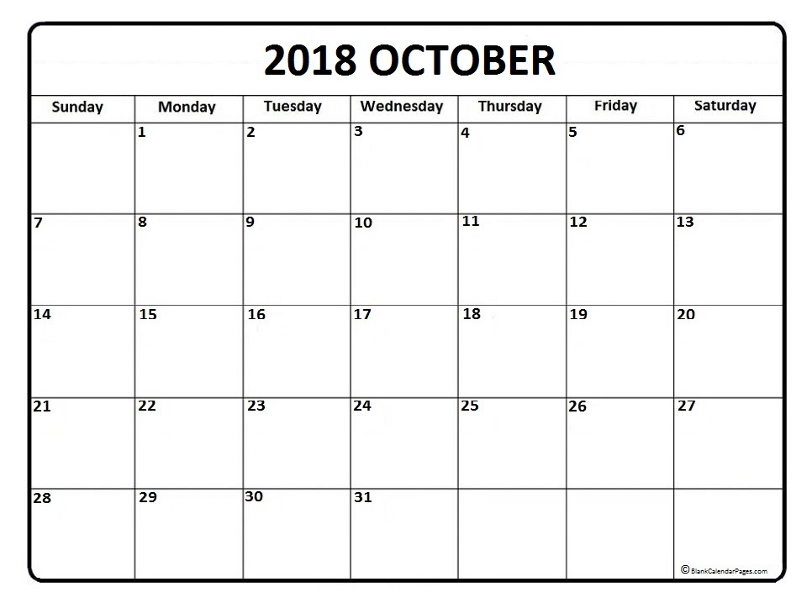
NAMA TALK 2018
EVENT CALENDAR

Slide 9
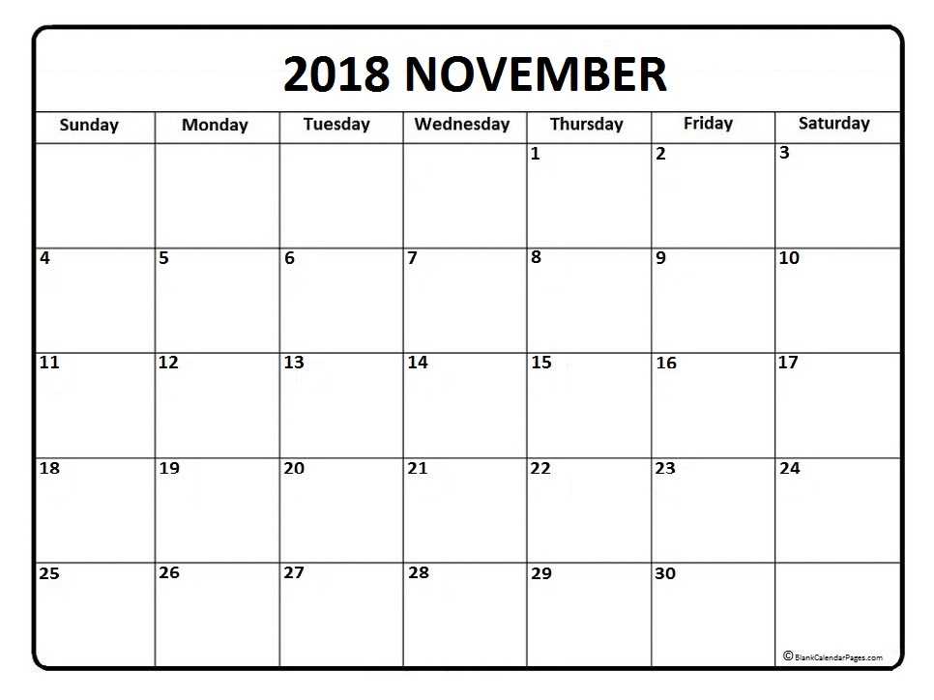
NAMA TALK 2018
EVENT CALENDAR

Slide 10
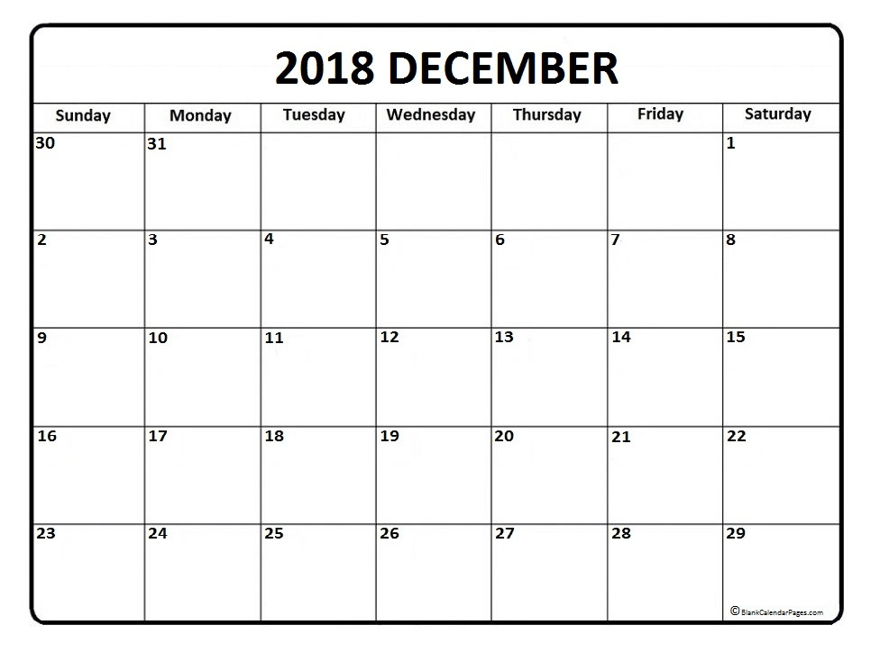
NAMA TALK 2018
EVENT CALENDAR

